Slide 1

Stage 5/Bay 4 J Turn Course Designer: Eric Beerbaum
J Turn is a 25 round, 125 point COMSTOCK Long course. There are 11 IPSC targets and 3 steel targets. The best 2 hits per cardboard target will score. Steel must fall to score.
The start position is hands touching the marks, firearm loaded on the barrel.
On the audible start signal, engage all targets from within the shooting area.

Slide 2
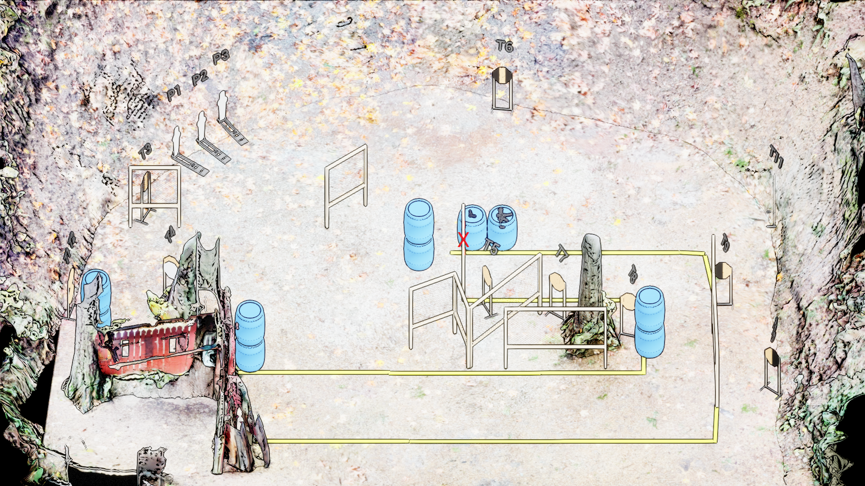
 | Stage 5/ Bay 4 J Turn Course Designer: Eric Beerbaum

